Slide 1
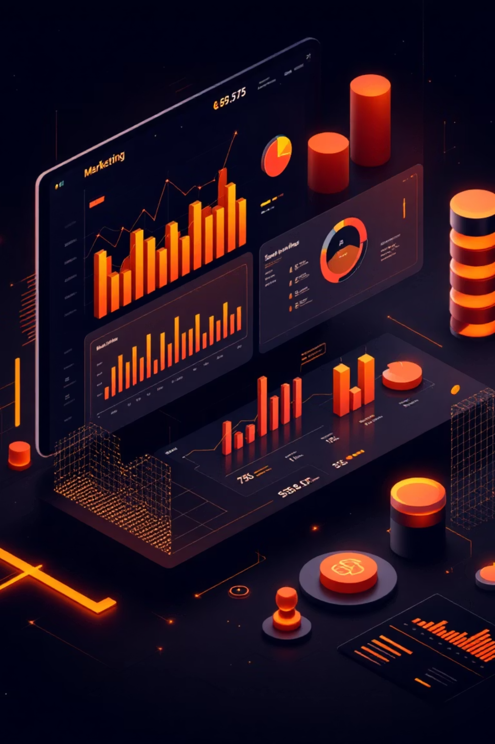
Data Presentation
Marketing Analytics Portfolio Project

Slide 2
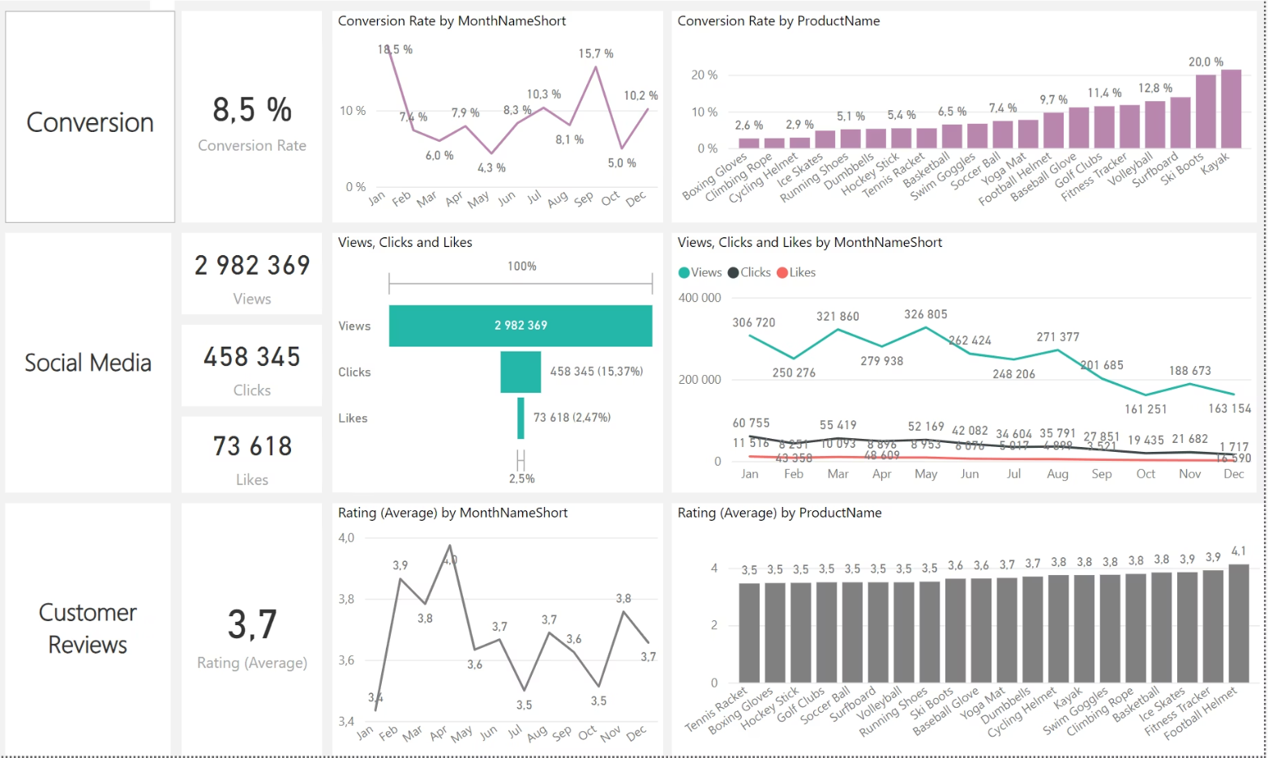
Overview of Key Marketing Performance Insights
This analysis delves into crucial marketing performance metrics, highlighting areas of success and opportunities for strategic improvement. We've identified key trends in conversion rates, customer engagement, and feedback that will inform our future marketing initiatives.
1
2
3
Decreased Conversion Rates
Reduced Customer Engagement
Customer Feedback Analysis
While December saw a strong rebound to 10.2%, conversion rates experienced a significant dip to 5.0% in October. This fluctuation indicates a need to investigate monthly performance drivers and optimize strategies for consistent growth.
Overall social media engagement shows a decline in views throughout the year. Although clicks and likes are comparatively low, the healthy 15.37% click-through rate suggests that users who do engage are highly interested, emphasizing the importance of attracting more engaged users.
Customer ratings have remained stable at an average of 3.7. However, this is below our target of 4.0, signaling a clear need for focused improvements in customer satisfaction, particularly for products with ratings below 3.5 stars, to enhance overall brand perception.

Slide 3
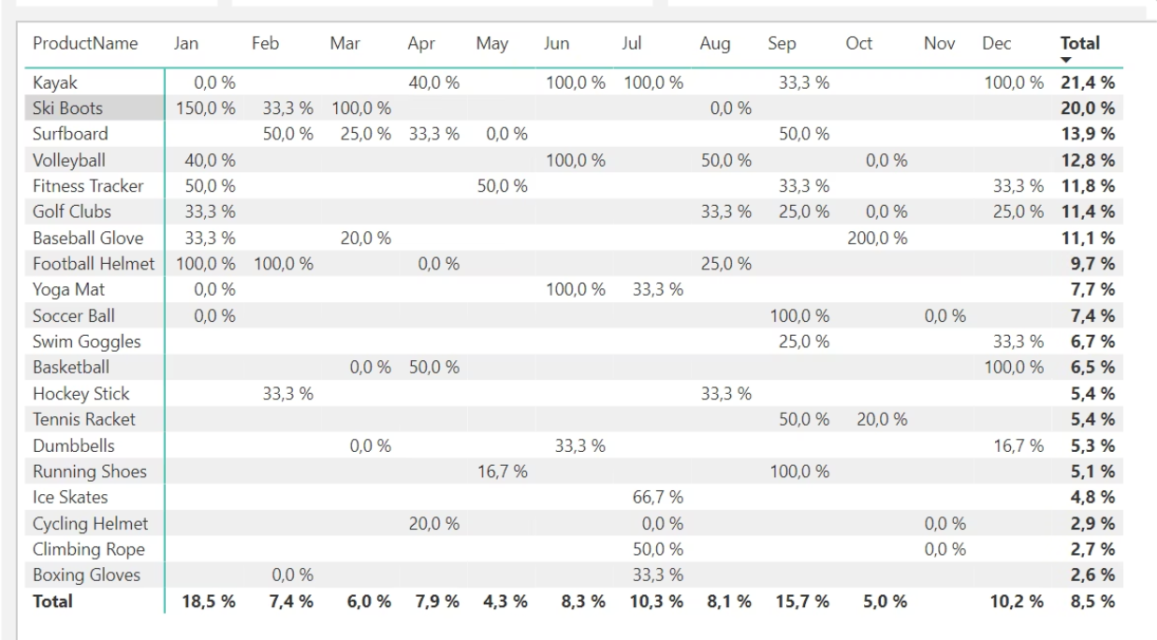
Deep Dive: Decreased Conversion Rates
Understanding the dynamics of our conversion rates throughout the year is crucial for optimizing our sales funnels and promotional activities. This section breaks down the monthly variations and identifies key periods for strategic intervention.
General Conversion Trend: Conversion rates exhibited significant monthly variations. Peaks in February and July suggest successful product-specific or seasonal campaigns during these periods. This variability highlights an opportunity to analyze the drivers behind these successes and apply similar tactics to boost conversions in lower-performing months.
Lowest Conversion Month: May recorded the lowest overall conversion rate at 4.3%, with no products achieving significant conversion momentum. This dip indicates a critical period for re-evaluating our marketing efforts, product positioning, or promotional offers to prevent similar declines in the future.
Highest Conversion Rates: January stood out with an impressive 18.5% overall conversion rate, largely propelled by Ski Boots achieving an extraordinary 150% conversion. This success underscores the power of strong seasonal demand combined with effective marketing. It also provides valuable insights into what drives exceptional performance across product categories.
The chart illustrates the fluctuation in conversion rates throughout the year, with a clear peak in January and a trough in May.

Slide 4

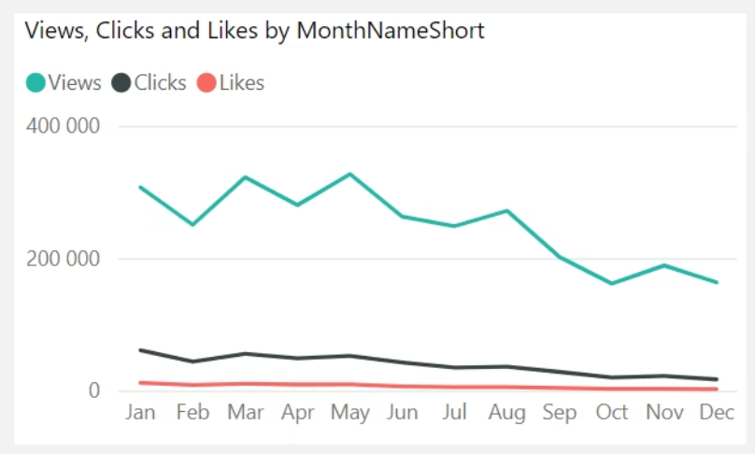
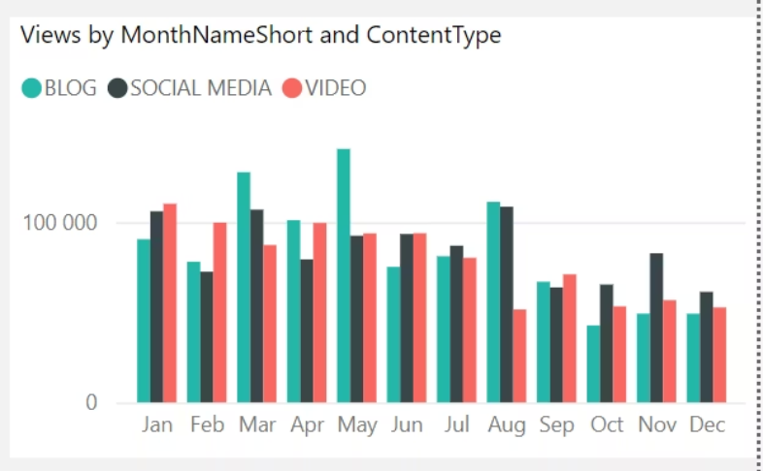
Analysis: Reduced Customer Engagement
Understanding audience engagement is pivotal for content strategy and marketing effectiveness. This section examines trends in views, interaction rates, and content performance across different platforms.
Declining Views
Low Interaction Rates
Content Type Performance
Views reached their highest points in February and July, demonstrating periods of strong audience interest. However, a noticeable decline from August onwards indicates a reduction in overall audience engagement during the latter half of the year. This trend requires immediate attention to reinvigorate content and outreach efforts.
Despite fluctuating views, clicks and likes remained consistently low relative to the view count. This suggests that while content might be seen, it often fails to prompt further interaction. A stronger emphasis on compelling calls-to-action and more interactive content formats is needed.
Blog content proved to be a significant driver of views, particularly in April and July, showcasing its potential as a high-engagement format. Social media and video content maintained steady, albeit slightly lower, engagement. This suggests a balanced approach to content creation, leveraging blog strength while enhancing other formats.
The charts above visually represent the trends in customer engagement, specifically highlighting views by content type and monthly interaction rates.

Slide 5
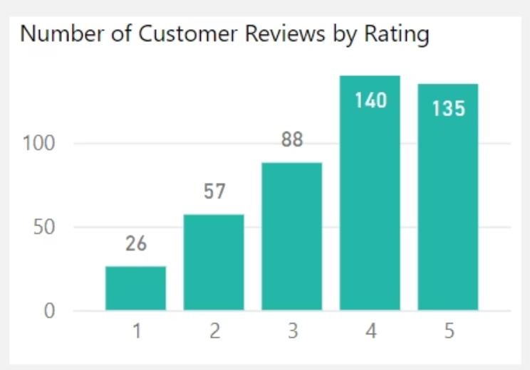
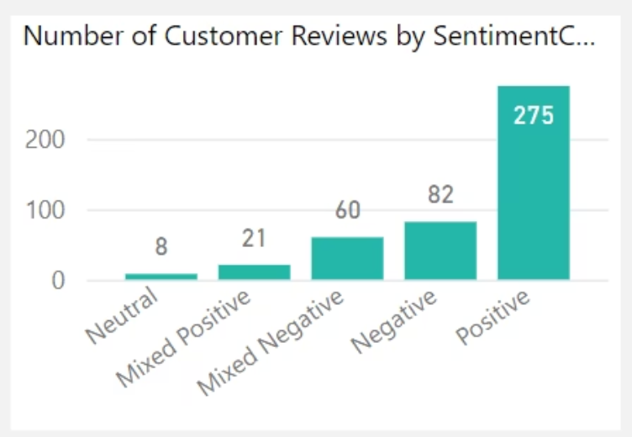
Customer Feedback Analysis: Uncovering Sentiment
Customer feedback is a direct reflection of satisfaction and an invaluable resource for product and service improvement. This section dissects our customer ratings and sentiment to identify areas of strength and opportunities for growth.
Customer Ratings Distribution: Our customer reviews demonstrate a strong positive bias, with the majority falling into the 4- and 5-star categories (140 at 4 stars, 135 at 5 stars). While this indicates general satisfaction, the presence of lower ratings (26 at 1 star, 57 at 2 stars) suggests specific pain points that need to be addressed to uplift overall sentiment.
Sentiment Analysis: A comprehensive sentiment analysis reveals that positive sentiment dominates with 275 reviews. This confirms a generally satisfied customer base. However, 82 reviews expressed negative sentiment, along with a smaller number of mixed and neutral sentiments. This nuanced distribution provides clear targets for intervention and improvement.
These visualizations illustrate the distribution of customer ratings and the overall sentiment breakdown, underscoring the areas requiring strategic attention.
Opportunity for Improvement: The existence of mixed positive and mixed negative sentiments presents a unique opportunity. By actively addressing the specific concerns highlighted in these mixed reviews, we can convert hesitant customers into enthusiastic advocates. Focused efforts on these areas could significantly boost our average rating and foster stronger customer loyalty.

Slide 6
Goals & Actionable Strategies for Marketing Enhancement
To leverage our analytical insights, we've defined clear goals and corresponding actions to drive tangible improvements across conversion, engagement, and customer satisfaction.
Goals
Actions
Increase Conversion Rates: Identify specific factors hindering conversion and provide data-driven recommendations. Our insight will highlight critical drop-off points in the customer journey and propose optimization strategies for a more seamless conversion funnel.
Increase Conversion Rates: Focus marketing efforts on historically high-performing product categories like Kayaks, Ski Boots, and Baseball Gloves. Implement targeted seasonal promotions and personalized campaigns during peak conversion months (e.g., January and September) to capitalize on established demand and maximize sales opportunities.
Enhance Customer Engagement: Determine which content types resonate most with our audience. We'll analyze interaction levels across all marketing content to inform and refine future content strategies for maximum impact.
Enhance Customer Engagement: Revitalize our content strategy by experimenting with highly engaging formats such as interactive videos, live Q&A sessions, or user-generated content campaigns. Optimize call-to-action placements within social media and blog content, especially during low-engagement periods (September-December), to drive greater interaction.
Improve Customer Feedback Scores: Uncover common themes in customer reviews, both positive and negative. Our actionable insights will guide product and service improvements, directly addressing customer concerns and reinforcing positive experiences.
Improve Customer Feedback Scores: Establish a robust feedback loop to thoroughly analyze mixed and negative reviews for recurring issues. Develop and implement concrete improvement plans based on these findings. Proactively follow up with dissatisfied customers to resolve issues, aiming to convert negative experiences into positive ones and elevate our average rating closer to the 4.0 target.

